Slide 1
Week 8: Let’s get to the point…
Spyros Mastorakis

Slide 2
Outline
Pointers
Project 6
Coding

Slide 3
Pointers
It is a method of locating variables (data) in your program (in memory)
Pointers store address in memory
- not the value

Slide 4
Declaring a pointer
It is not the same thing to point to a char and to point to an integer or a float
Examples:
- int* number;
- char* character;
- float* greatnumber;

Slide 5
* Means different things
Similar to arrays
- [] in variable declaration means size
- [] in code execution means position in array
With pointers
- * in variable declaration means it is a pointer
- * in code execution means get value by address

Slide 6
Reference operator
By reference people understand “by address”
By address people understand “by reference”
Operator & does
- Returns the address of a given variable name
- With every program run this address changes
- You cannot hardcode addresses

Slide 7
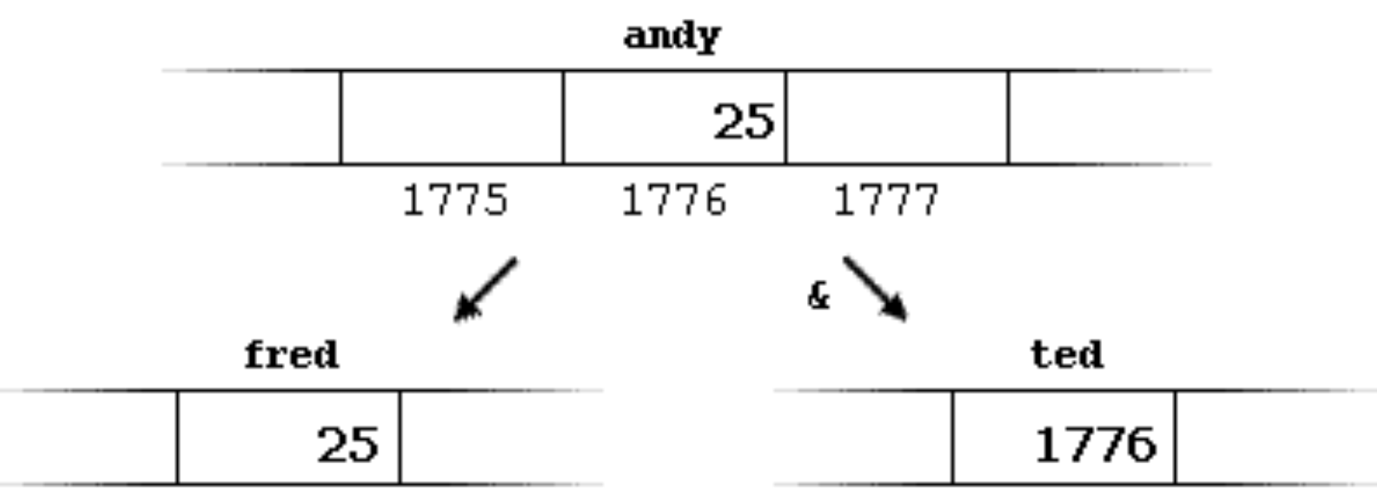
Example
andy = 25;
fred = andy;
ted = &andy;

Slide 8
Dereference operator
Gets the value of a variable by a given address
Dangerous operation:
- Results in many bugs
- The type of the variable must match the type of the variable at the specified address

Slide 9
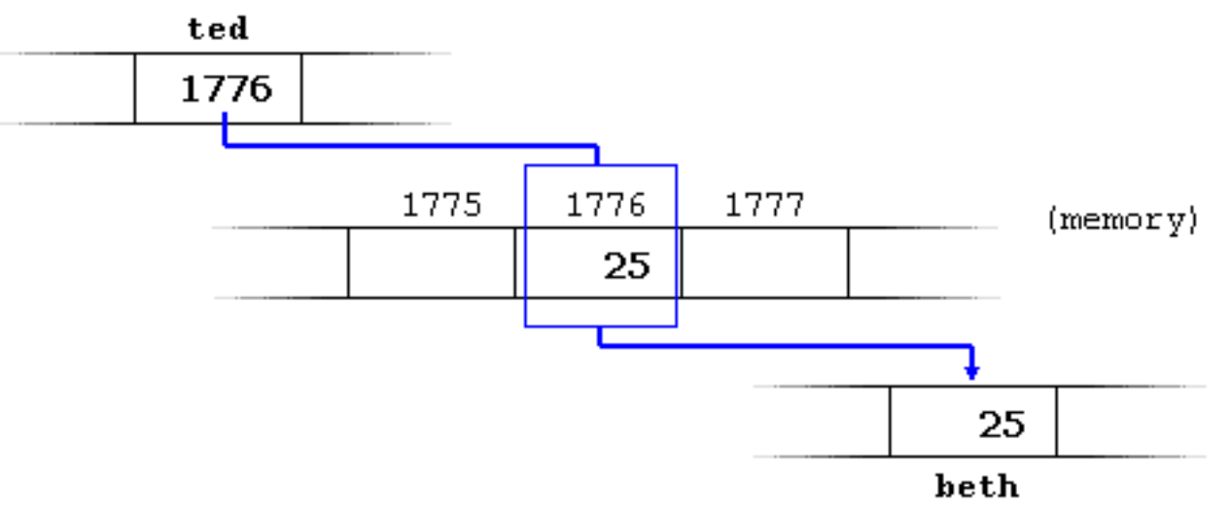
Example
beth = *ted;

Slide 10
Summary
& is the reference operator and can be read as "address of"
* is the dereference operator and can be read as "value pointed by"

Slide 11
Exercise (1)
#include <iostream>
using namespace std;
int main ()
{
int firstvalue, secondvalue;
int * mypointer;
mypointer = &firstvalue;
*mypointer = 10;
mypointer = &secondvalue;
*mypointer = 20;
cout << "firstvalue is " << firstvalue << endl;
cout << "secondvalue is " << secondvalue << endl;
return 0;
}

Slide 12
Exercise (2)
#include <iostream>
using namespace std;
int main ()
{
int firstvalue = 5;
int secondvalue = 15;
int * p1, * p2;
p1 = &firstvalue;
p2 = &secondvalue;
*p1 = 10;
*p2 = *p1;
p1 = p2;
*p1 = 20;
cout << "firstvalue is " << firstvalue << endl;
cout << "secondvalue is " << secondvalue << endl;
return 0;
}

Slide 13
Pointers and Arrays
int numbers [] = {1, 2, 3};
int * p;
p = numbers;
1) What is going on here?
2) What will happen if I type:
std::cout << *p;

Slide 14
Pointers and Arrays
a[5] = 0; // a [offset of 5] = 0
*(a+5) = 0; // pointed by (a+5) = 0

Slide 15
Exercise
int main ()
{
int numbers[5];
int * p;
p = numbers;
*p = 10;
p++;
*p = 20;
p = &numbers[2];
*p = 30;
p = numbers + 3;
*p = 40;
p = numbers;
*(p+4) = 50;
for (int n=0; n<5; n++)
cout << numbers[n] << ", ";
return 0;
}

Slide 16
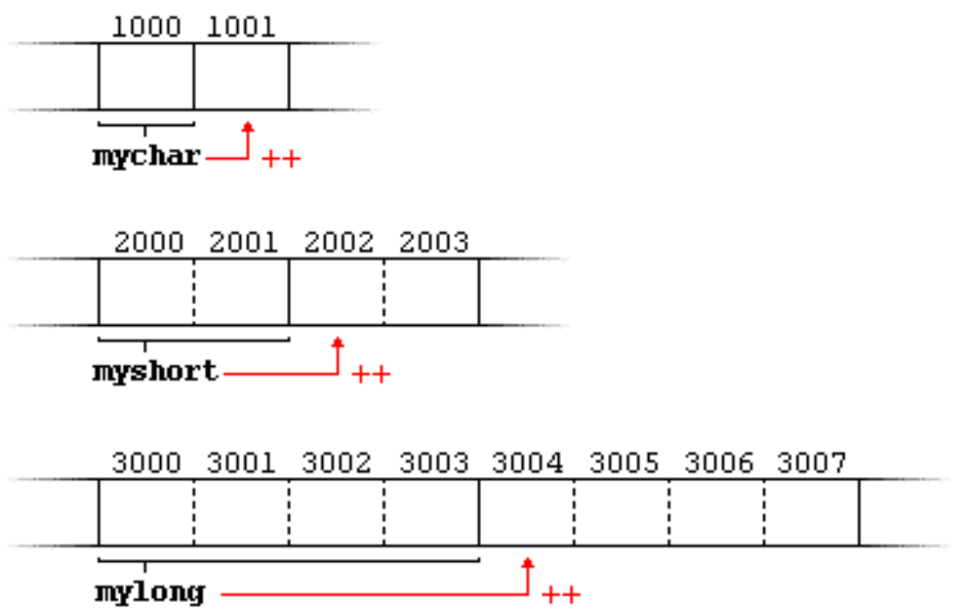
Pointer arithmetic (1)
mychar++;
myshort++;
mylong++;

Slide 17
Pointer arithmetic (2)
*(p++)
(*p)++
What is going on here?

Slide 18
Pointer arithmetic (3)
*(p++) – increases pointer to the next memory location
(*p)++ - increases the value stored in memory

Slide 19
Project 6
Let’s take a look

Slide 20
WE ❤️ CODING! ☺

Slide 21
Problem 1
Iterate over the elements of an array using pointers and find their average value

Slide 22
Problem 2
Allocate a 1D array using pointers

